Slide 1

OOSE Final Presentation
Chenghao Sun, Nanxi Ye, Zixuan Yao, Ziyi Wang, Wenling Ding, Ziming Chen
Apr 28, 2020

Slide 2










Our Solution: QuizHero
create
share
participate

Slide 3
Shortcomings
Instructors shift between different windows/softwares
Students use additional platforms or tools to take quiz
Instructors don’t have clear records of students’ response
Hard to manage file access and uploading history

Slide 4

Our Solution: QuizHero
Present Slides
Start Quizzes
Monitor Statistics
create
share
participate

Slide 5
User Stories
As an instructor, I want to…
Login
Upload
Present
Share
Quiz
Statistics
History
As a student, I want to…
View slides
Quiz

Slide 6
Live Demo: 4 members & cover all Must-Haves
Member 1
Member 2
Login
View Slides
As an instructor, I want to log in to the website, so that I can have my personal record.
As a student, I want to view the slides uploaded by the instructor so that I can keep pace with the lesson.
Upload
Take Quiz
As an instructor, I want to upload a markdown file containing the quiz questions and lecture slides, so that I can start a quiz during the class.
As a student, I want to answer the quiz so that I can interact with the instructor during class.
Start Sharing
(Instructor starts quiz meanwhile --- also Nice-to-have 2)
As an instructor, I want to control the permission of opening the files I upload, so that I can prompt my students to view the slides at the right time. (Nice-to-have 1)
Share file code in Zoom chat

Slide 7
Live Demo: 4 members & cover all Must-Haves
Member 3
Member 4
Presenter Mode
Review History
As an instructor, I want to have a presenter mode to see all my slides, quizzes and notes, so that I can teach a course and have a better overview of my teaching content.
As an instructor, I want to review my presentation history, so that I can go through what I have taught.
Option + P
Delete, view, download, start sharing ...
View Statistics
As an instructor, I want to collect students' answers and see relevant statistical data on my computer, so that I can know how students perform.

Slide 8
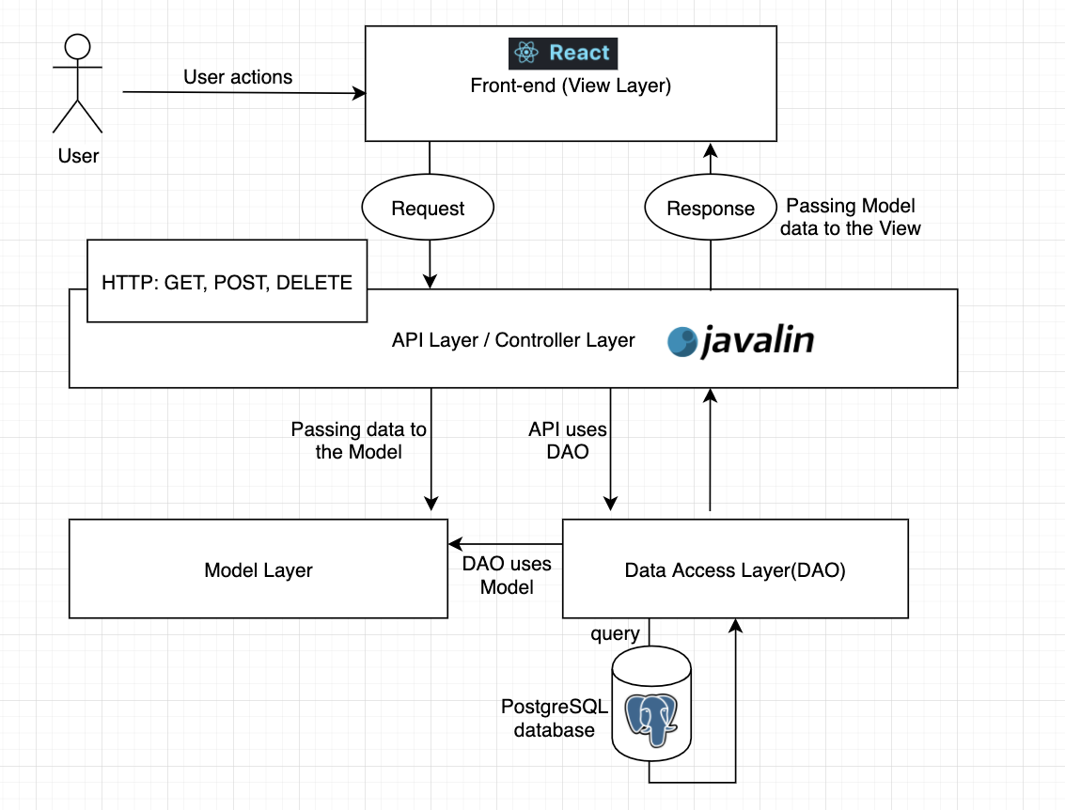
High-Level Deployment Architecture
Client-Server Architecture
RESTful API & HTTP protocol
MVC Design Pattern
DAO Design Pattern
Notes:
Conforms to Client-Server architecture
Use RESTful API and HTTP protocol to implement the interactions between two systems
Use React to develop front-end, which is the client-side that displays the views and interacts with end-user
Use Javalin to develop API server that handles requests from the View Layer and passes data to the Model Layer, API server is the Controller layer in MVC pattern.
API server will also use Data Access Layer to interact with our database, and send appropriate data back to the client.
So this is our overall deployment architecture.

Slide 9
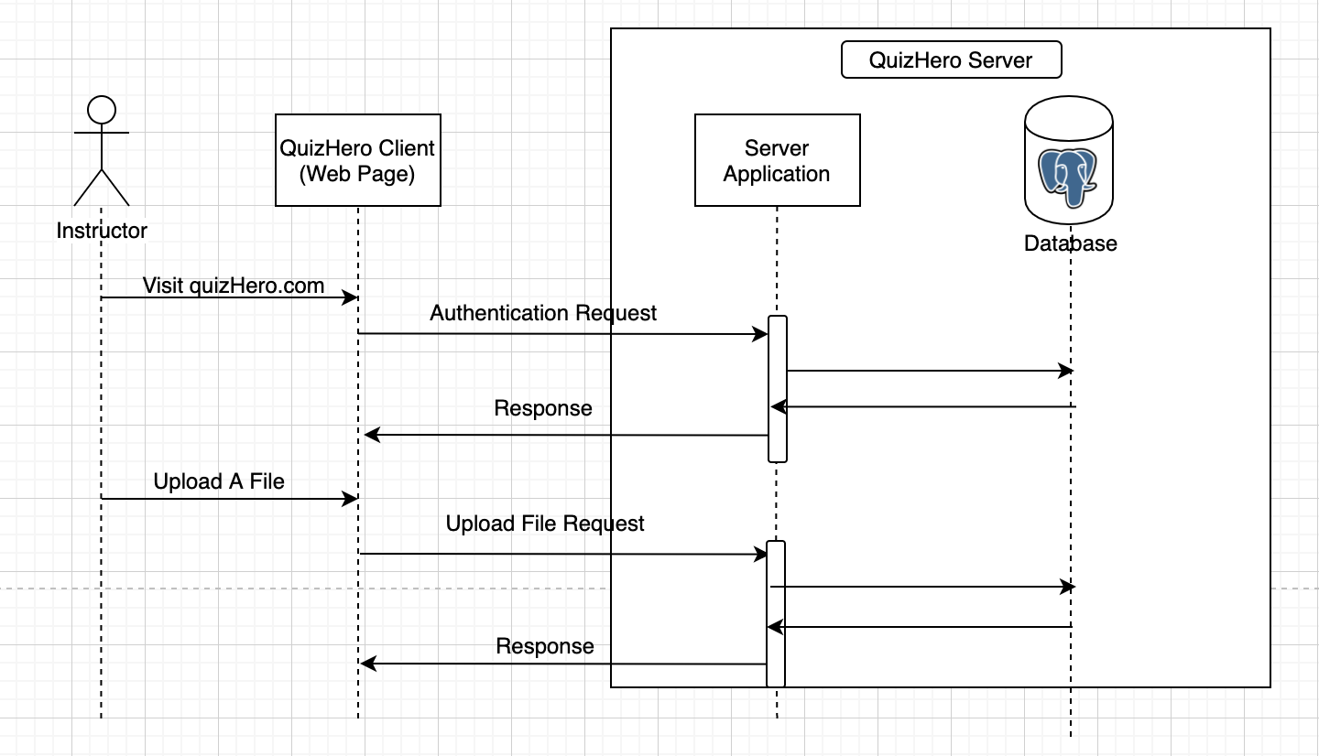

Slide 10
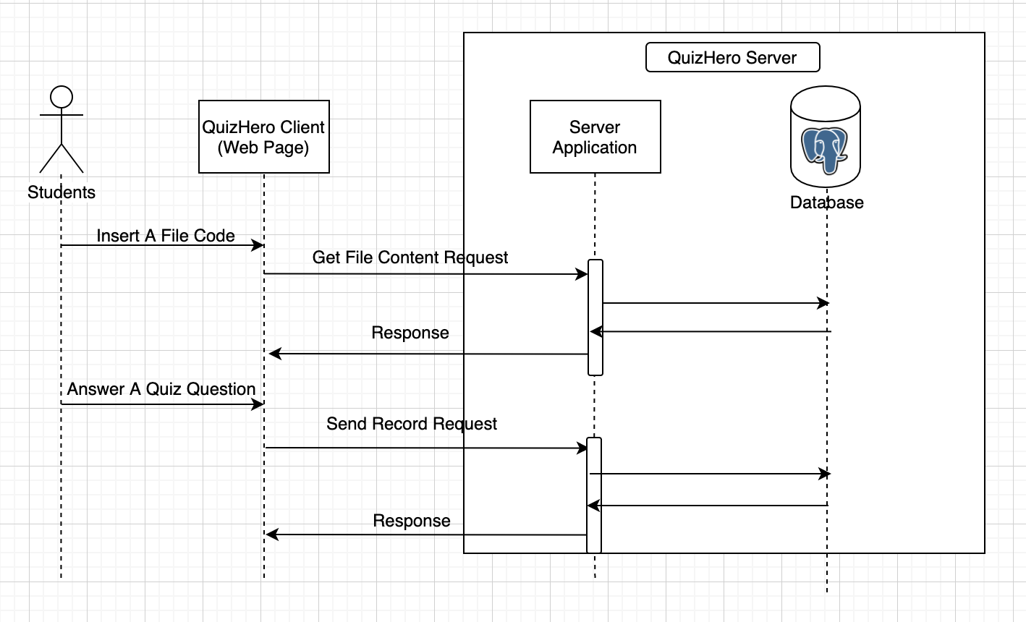

Slide 11
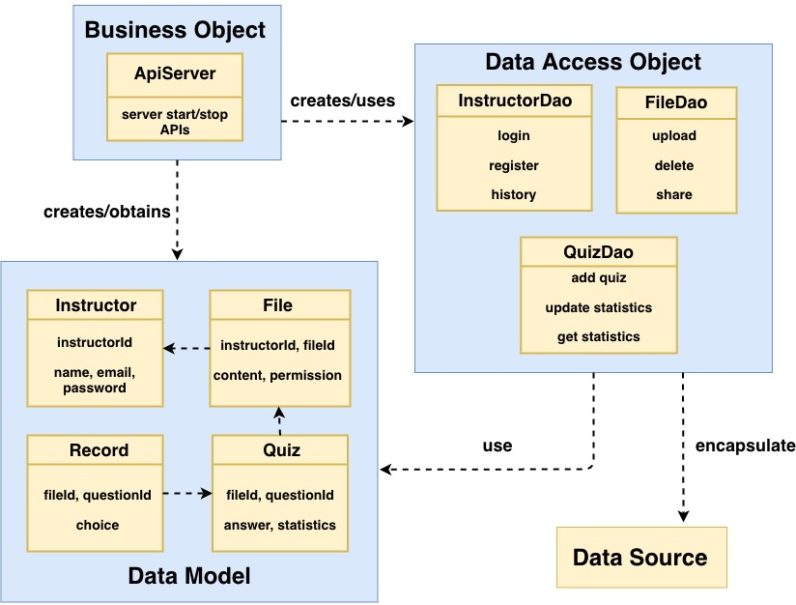
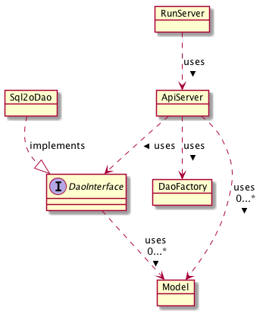
Overview of Design: Back-end Server

Slide 12
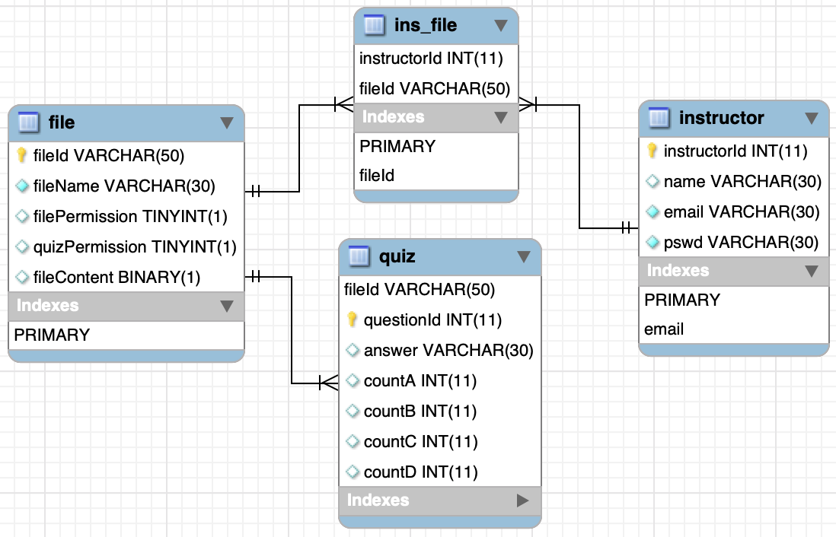
Overview of Design: Database ER Diagram
PostgreSQL: store file stream in database.
Used Normalization technique:
e.g. ins_file holds the relationship between instructors and files.
3NF: Reduce redundancy & easier to maintain.
Notes:
Creates a new table called ins_file, which holds the relationship between instructors and all the files they uploaded before. In this way, we minimize the data redundancy.
And finally, our database is in Third Normal Form, there is no partial functional dependency or transitive dependency. Our database is robust and easy to maintain.

Slide 13
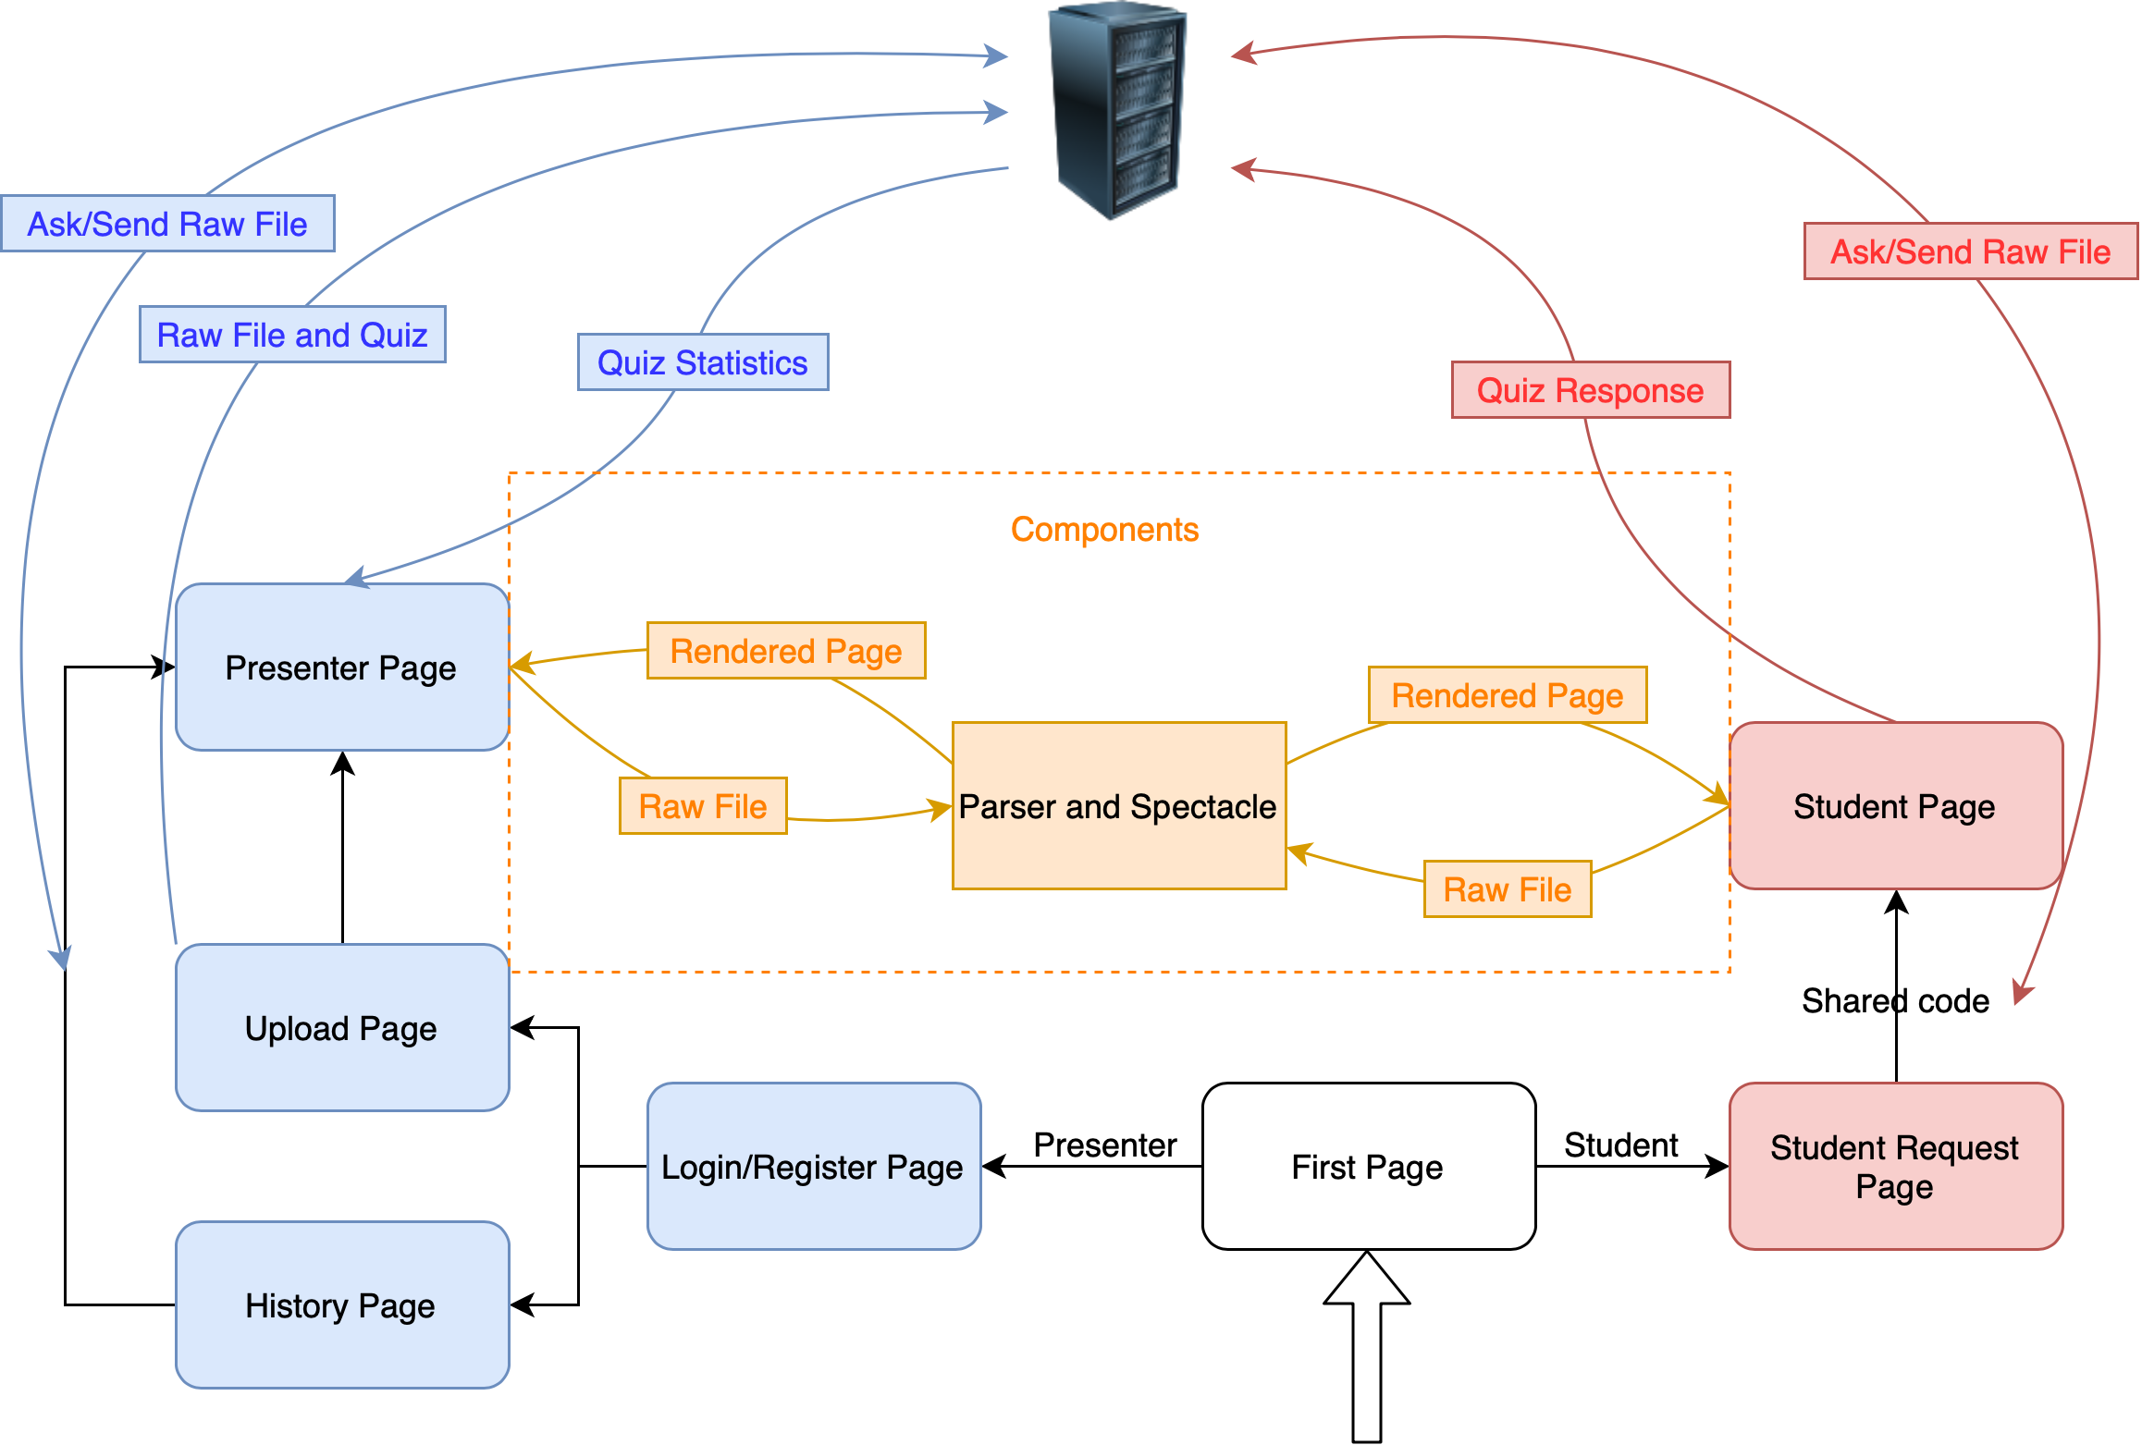
Overview of Design: Front-end
Notes:
This is the overview of the front end structure.
As you have probably experienced in our demo, we separate the front end into 7 pages. After the First Page, users are separated to Presenter and Student.
For presenter, users are required to login or register, upload, history,
For student, no login is required,
We developed a number of components to support our most important pages: student page and presenter page. Among them, the most important one is Parser and Spectacle. They will work together and take the raw md file and return a rendered dynamic page. Bob and wenling
The main difference between Presenter and Student page is

Slide 14
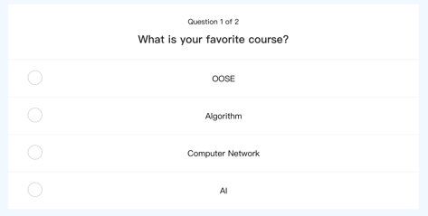
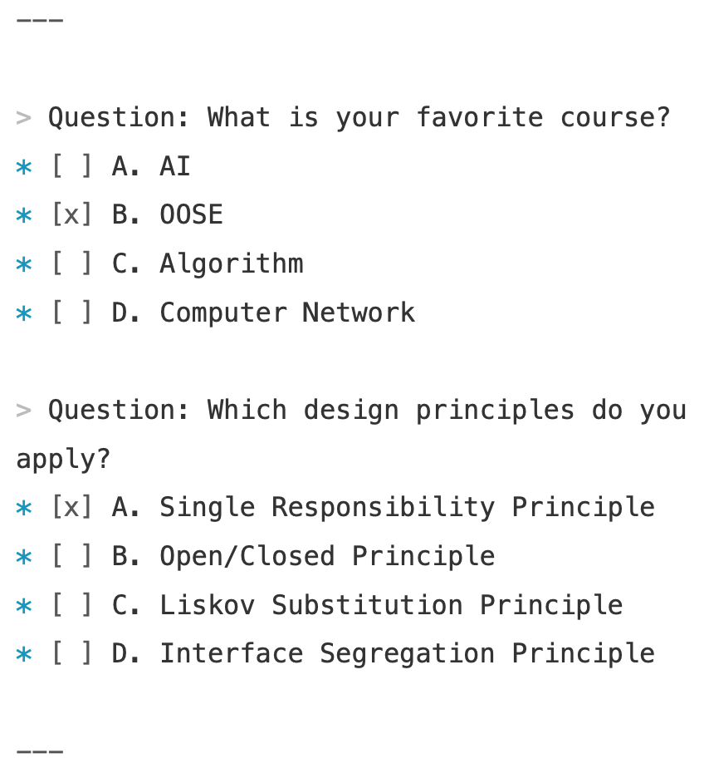
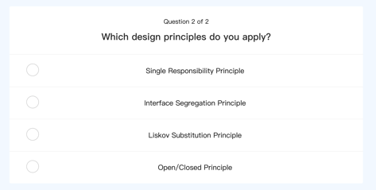
Parsing Algorithms：Parse Content from Markdown
QuizHero
QuizHero

Slide 15
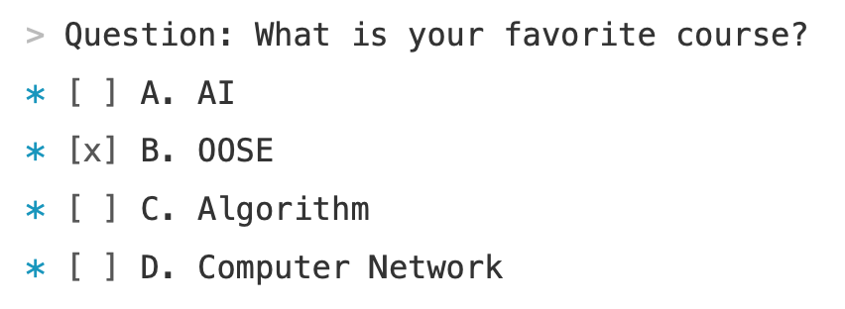
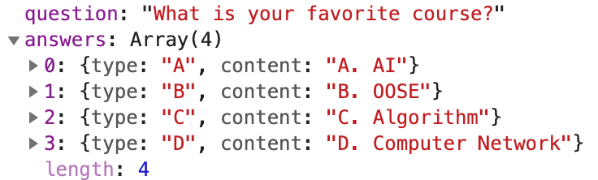
Parsing Algorithms：Parse Quiz Using Special Marks
> Question: marks question topic
* [ ] marks wrong option
* [x] marks correct option

Slide 16
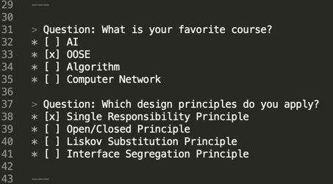
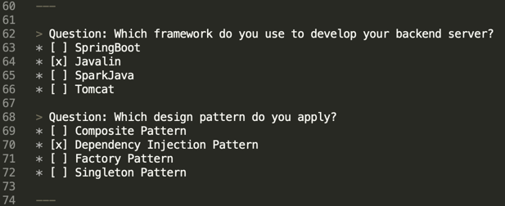
Parsing Algorithms：“Quiz Blocks” in different places
Use “---\n\n” to separate different “quiz blocks”.
“Quiz Block 1”, “Quiz Block 2” in different places of the slides becomes feasible.
Quiz
QuizBlock 1
Quiz
QuizLists
More flexible!
QuizBlock 2

Slide 17
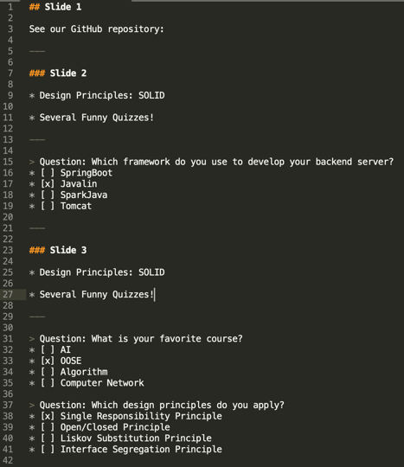
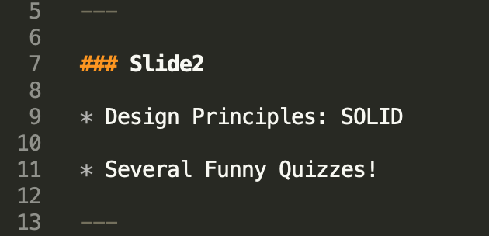
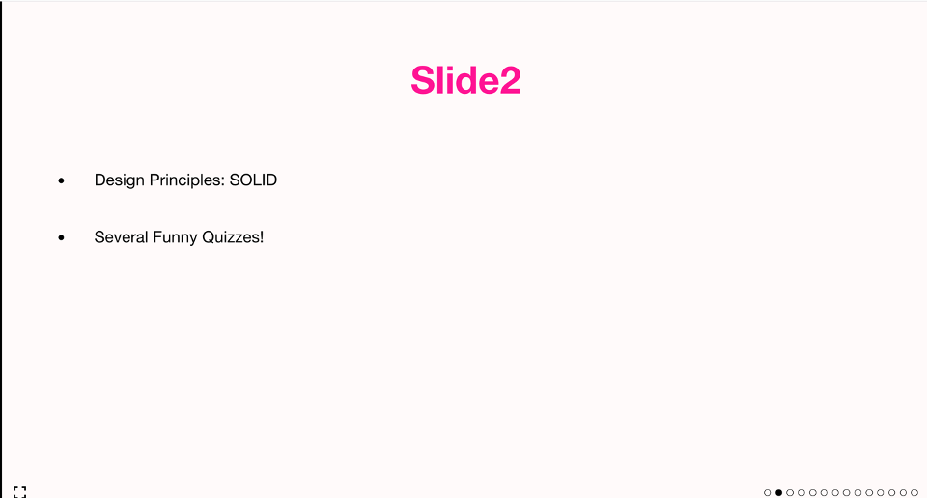
Parsing Algorithms：Seperate Slides and Quizzes
Slide[0]
Section
Slide[1]
Question[0] / Slide[2]
Spectacle

Slide 18
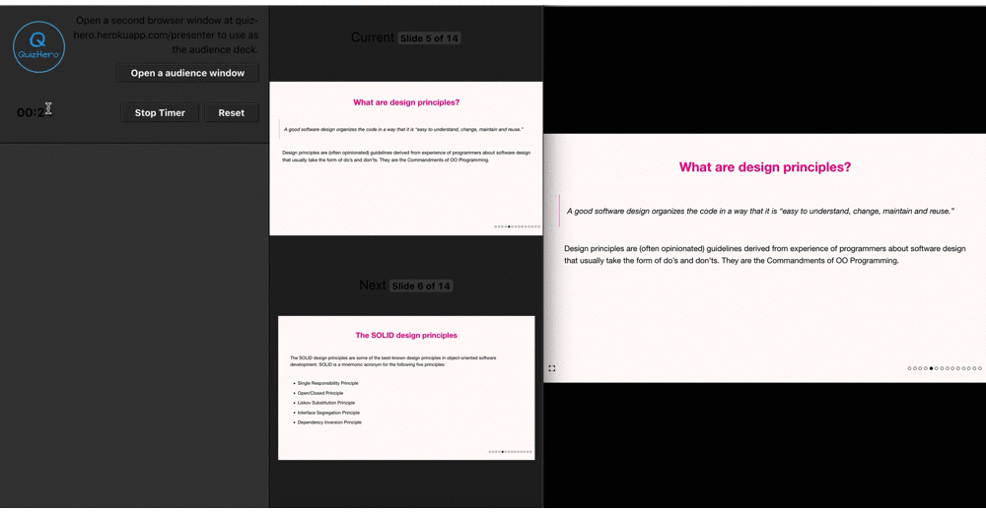
Plugins: Spectacle
Converted markdown to slides (after our parsing algorithm)
(render quiz pages by ourselves)
Modified source code (layout, color, font, etc)
Notes:
The fundamental plugin we use to convert raw markdown to slides
After the markdown content is processed by our parsing algorithm, we call Spectacle to convert the content of slides, and we render the quiz pages by ourselves.
Note that we also modified the source code …….

Slide 19
Limitation
Quiz format: only MCQ (at most 4 options)
Cannot edit an existing presentation (already uploaded)
Not support complicated slides well (e.g. the current presentation slide)

Slide 20
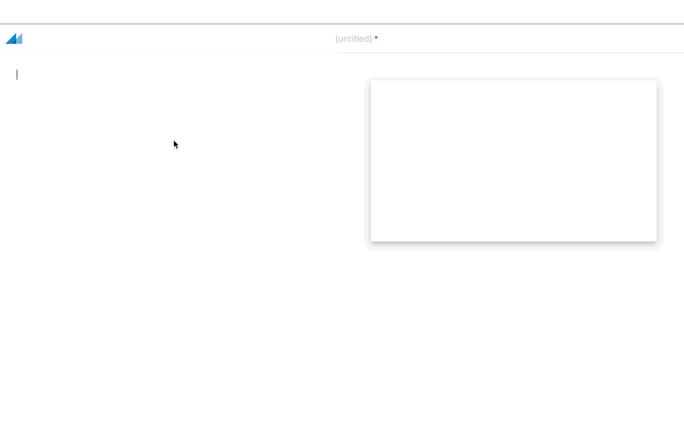
Future
Real-time editing and rendering!

Slide 21
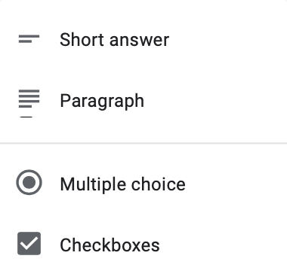

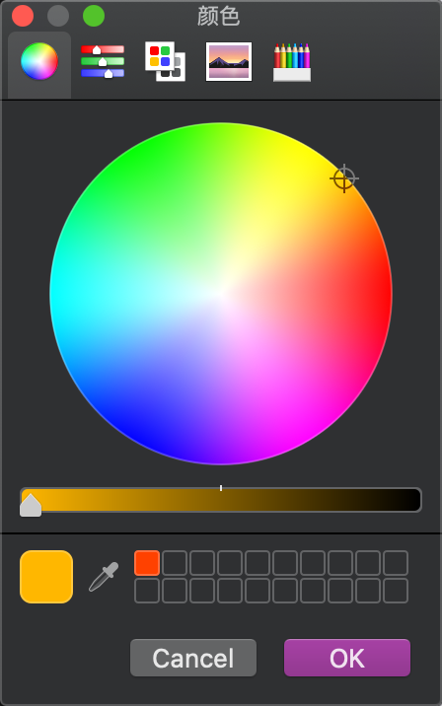
Future
More quiz options
Support third-party login: Google, Facebook, JHU(Microsoft), etc
Customize presentation style
2 small nice-to-have left: student download permission, quiz timer

Slide 22
Take-away
"The beginning is always the hardest". (frameworks, model, database, plugins… etc )
It is important to build a robust architecture at the beginning
More clear idea of the whole structure and technique stack
Learn things from official documents
Make the most of Github
Notes:
we were not sure what frameworks we should finally choose; how the Model, DAOs and database should be designed; what plugins we could use to import to our code and convert the markdown file successfully; how we could parse and extract quiz contents from markdown file;
Add features in the later iterations
RESTful API HTTP protocol we even ran into trouble for the combination of front-end and back-end code as well as the communications between the two systems in the beginning.

